Slide 1
AWS DevOps INTERNSHIP MINI PROJECT – 2
By MUJAHID SHAIK

Slide 2
LABS :
PROVISIONING EC2 INSTANCE
CREATING REPOSITORY IN LOCAL MACHINE
CREATING REPOSITORY IN REMOTE LOCATION
WORKING WITH REMOTE REPOSITORY
PUSHING A LOCAL REPOSITORY TO GITHUB
CREATING A NEW BRANCH FROM MAIN
PULLING ALL BRANCHES FROM MAIN
MERGING NEW BRANCH WITH MAIN BRANCH
PULLING NEW CHANGES IN LOCAL REPOSITORY

Slide 3
LAB – 1 [PROVISIONING EC2 INSTANCE]
TASKS TO DO :
Provision an EC2 Instance.
Access the Instance

Slide 4
Login to AWS management console.
Open EC2 service and click on Launch Instance.
Give a name to your Instance.
Select Amazon Linux 2 free tier OS in AMI section.
Select instance type as t2 micro.

Slide 5
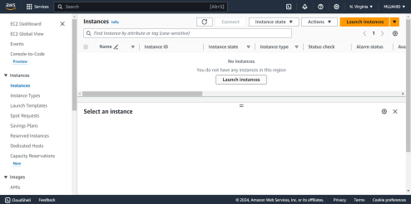
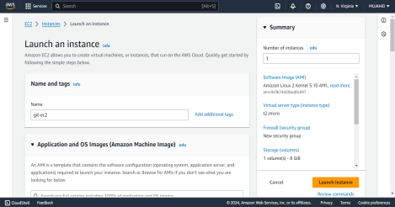
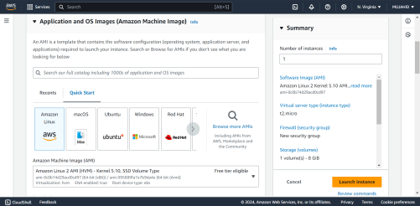
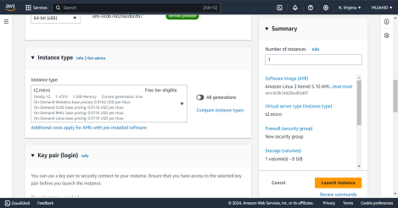

Slide 6
Create a keypair to Login to your Instance.
In the networking section, Add an Inbound rule allowing port 22 from My IP to access Instance.
Check all the configurations you made and click on launch Instance.
Copy the public IP of the Instance and open shell
Execute this command to login to your Instance.
ssh -i <keypair> <username>@IP

Slide 7
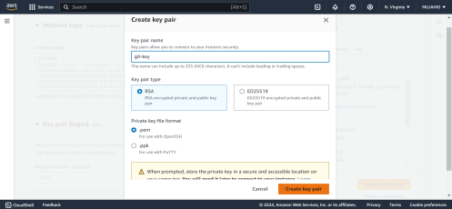
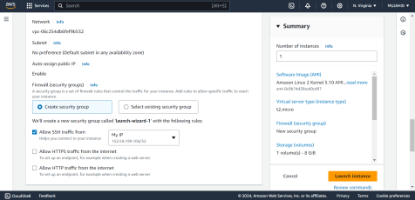
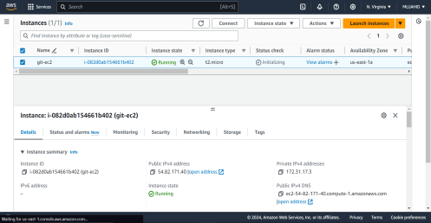
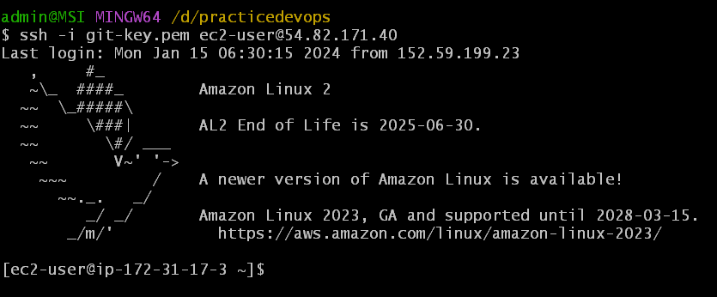

Slide 8
LAB – 2 [CREATING REPO IN LOCAL MACHINE]
TASKS TO DO :
Create a directory in Local Machine.
Initialize this directory
Add some files in this directory and commit them.

Slide 9
Create a directory using command [mkdir <directory name>]
Initialize this directory using command [git init]
Add some files in it using command [touch filename{1..10}.doc].
Add these files from working area to staging area using command [git add .]
Check the status of the files using command [git status]
Commit these files using command [git commit –m “commit message”]

Slide 10
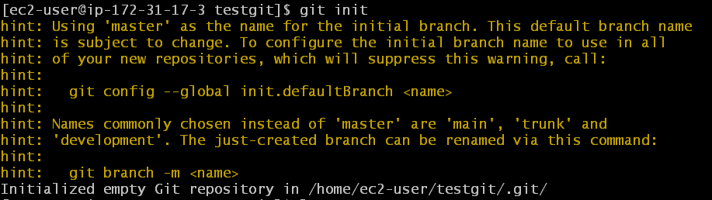
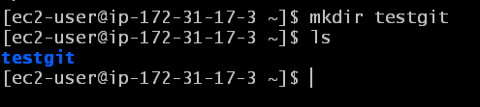
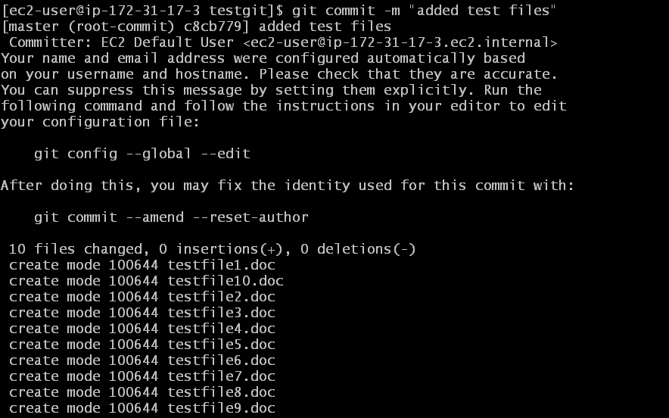
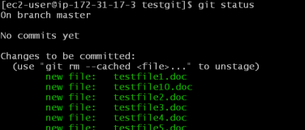

Slide 11
LAB – 3 [CREATING REPO IN REMOTE LOCATION]
TASKS TO DO :
Create a private repository in git hub remote platform.
Initialize this repository.

Slide 12
Login to Git hub platform using your account credentials.
Click on + to create a New repository.
Give a name to your repository and can add description that is optional.
Initialize this repository putting a check mark on .README file.
Click on create repository.

Slide 13
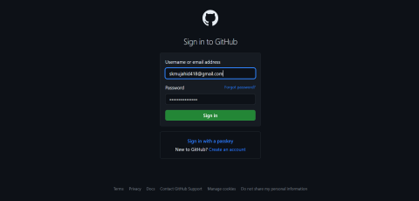
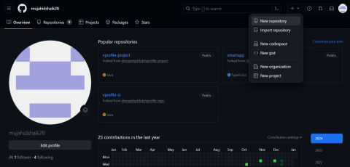
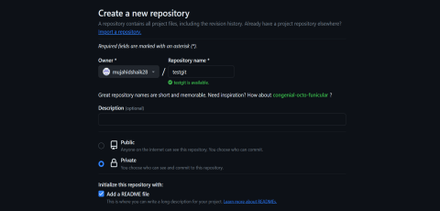
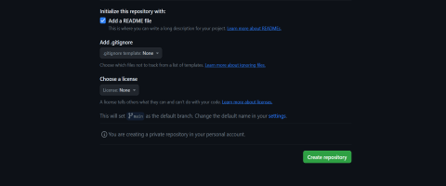

Slide 14
LAB – 4 [WORKING WITH REMOTE REPOSITORY]
TASKS TO DO :
Clone the remote repository in to your local machine.
Create some empty files in this repository.
Commit these changes and push them to the remote repository.

Slide 15
Clone the remote repository in to your local machine using command
[git clone <REPO URL>]
While cloning, In the password authentication paste the git access token.
To generate git access token, click on account settings in the git hub > Developer settings > Tokens (classic) > Generate new token (classic) .
Give a name to the token and put a check mark on repo, scroll down and click on create.

Slide 16
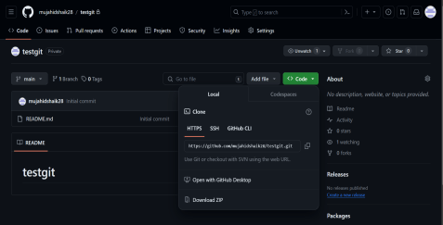
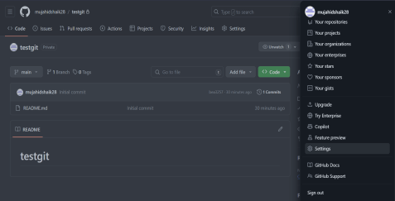
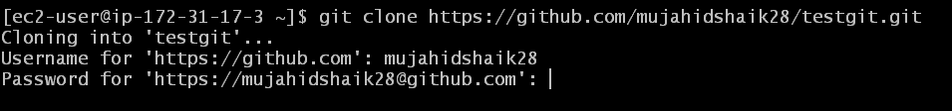
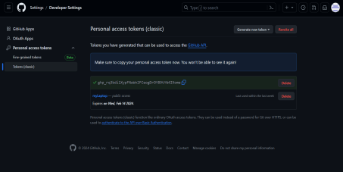
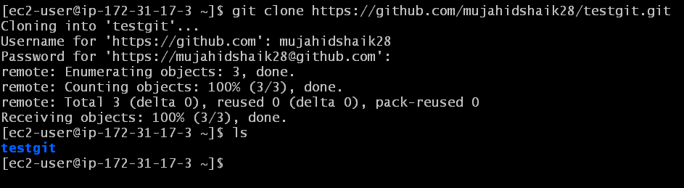

Slide 17
After cloning this repository, create some empty files in it.
Add these files from working area to staging area using command [git add .]
Commit them using command [git commit –m “commit message”]
After commit, push these files to remote repository using command [git push]
Check the files in the remote repository of git hub platform.

Slide 18
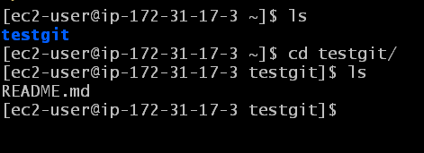
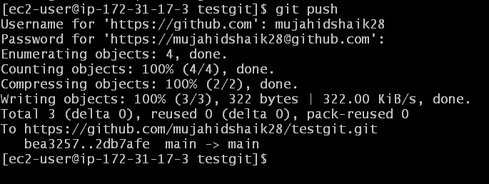

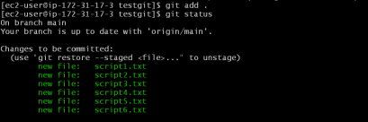
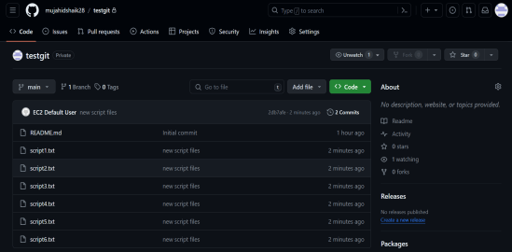
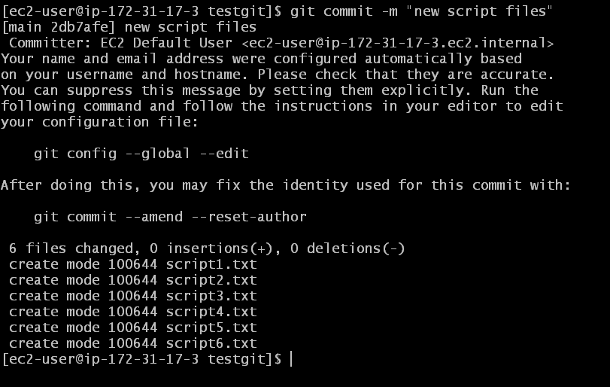

Slide 19
LAB – 5 [PUSHING A LOCAL REPO TO GITHUB]
TASKS TO DO :
Create a repository in your local machine and initialize it.
Create some empty files in it and commit them.
Create a remote repository in git hub with same name as in your local machine.
Push the local repository files to remote repository.

Slide 20
Create an Instance in AWS EC2 service and Login to it.
After logging inn Install git using command
[sudo yum install git -y]
Create a directory in your Local machine and Initialize it using command [git init]

Slide 21
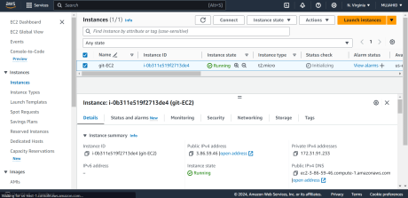
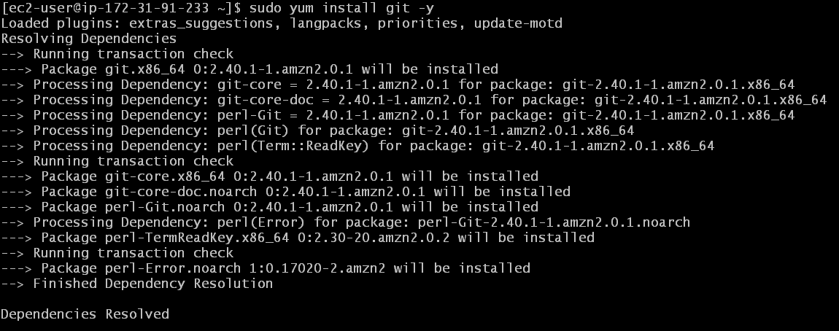
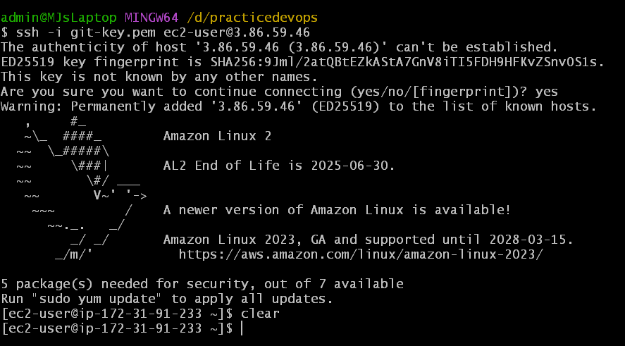
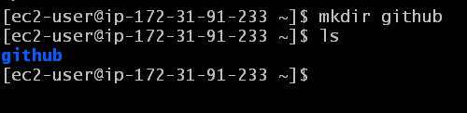
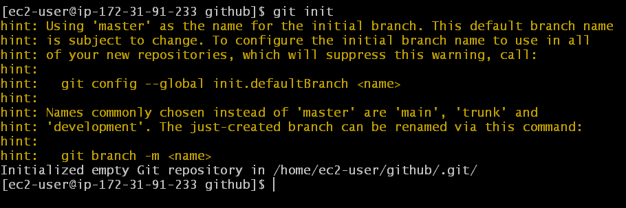

Slide 22
Add some empty files and commit them using command
[git commit –m “commit message”]
Now create a new remote repository in git hub remote platform with same name as you created in your local machine.

Slide 23
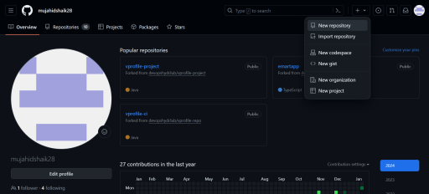
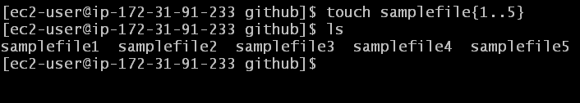
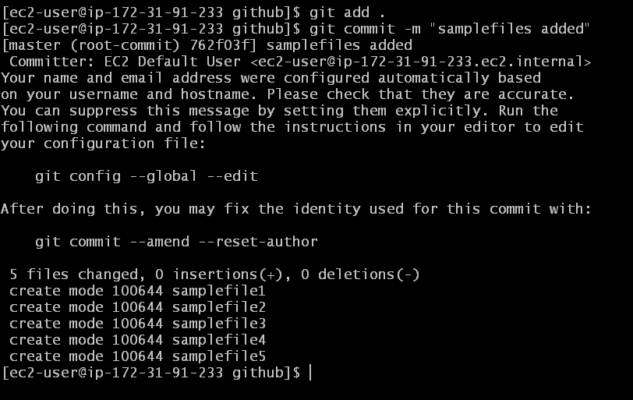
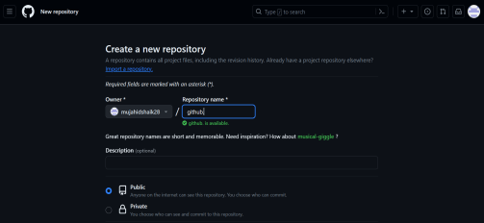

Slide 24
After creating the repository execute these following commands
[git branch –M main]
[git remote add origin <REPO URL>]
[git push –u origin main]
Now all the files have been pushed to remote repository.
Check the status in the git hub.

Slide 25
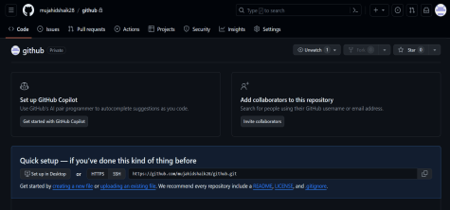
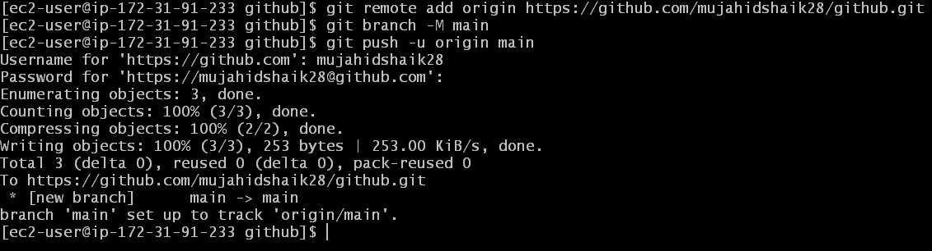
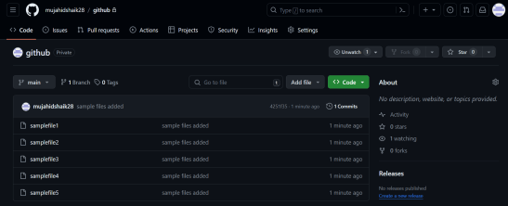

Slide 26
LAB – 6 [CREATING A NEW BRANCH FROM MAIN]
TASKS TO DO :
Create a new branch from main branch in Git Hub remote platform

Slide 27
Open your remote repository in Git Hub, click on Main and then give a new name to create a new branch out of Main branch.
And then click on create branch below it.
We see a new copy of main branch has created with your desired name.

Slide 28
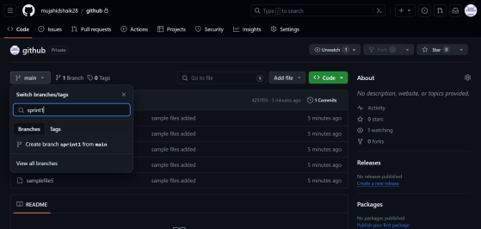
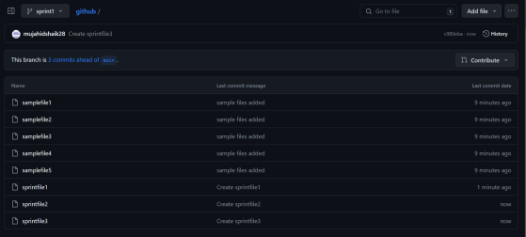

Slide 29
LAB – 7 [PULLING ALL BRANCHES IN LOCAL MACHINE]
TASKS TO DO :
Pull all the branches from remote repository.
Makes changes in the new branch.
Commit them and push them back to the Git Hub remote Repository.

Slide 30
Get in to your local machine where you created the previous directory.
Pull the new branches from remote repository to local machine using command [git pull].
Switch to the new branch and create some new files.
Add these files from working area to staging area, then commit them using command [git commit –m “commit message”]
Push these changes to remote repository using command [git push]

Slide 31
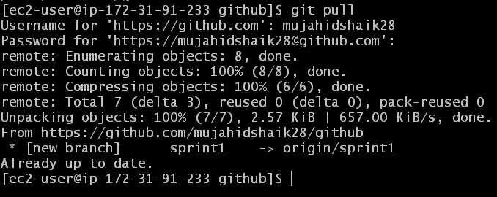
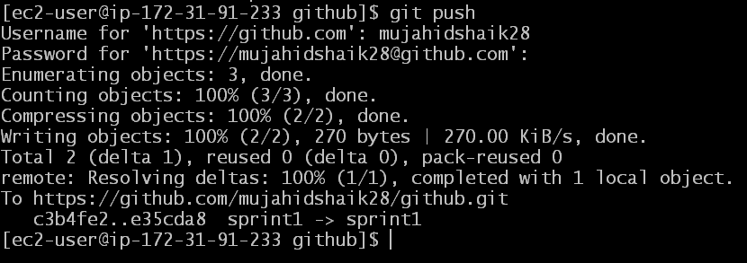
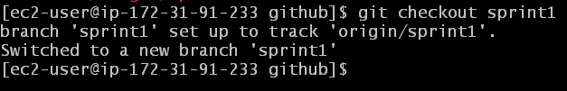

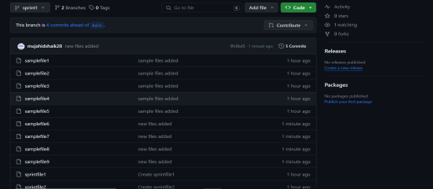
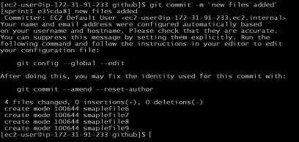

Slide 32
LAB – 8 [MERGING NEW BRANCH WITH MAIN BRANCH]
TASKS TO DO :
Merge the changes in the New branch to Main branch using Pull Request.

Slide 33
Open your repository in Git Hub remote platform and click on pull requests tab.
Click on compare and pull request as it is shown by default cause the branches don’t match.
You can either add a comment or can skip, then click on create pull request.

Slide 34
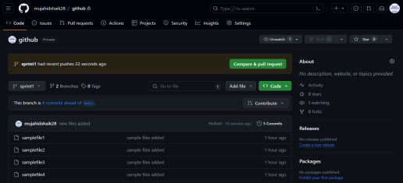
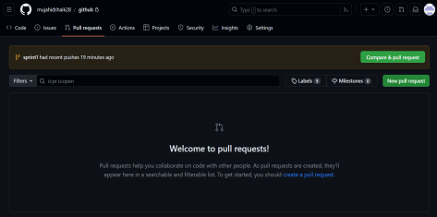
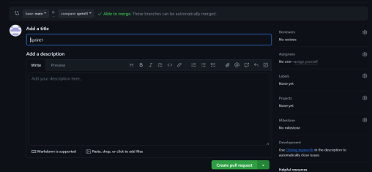
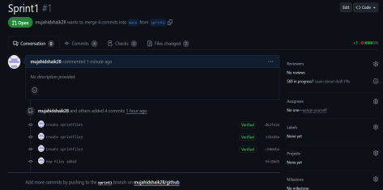

Slide 35
Now the pull request has been created, you can check that in the pull requests tab.
Click on Merge Pull request and confirm the Merge.
Compare the files of New branch and Main branch.
Both of them are now similar.

Slide 36
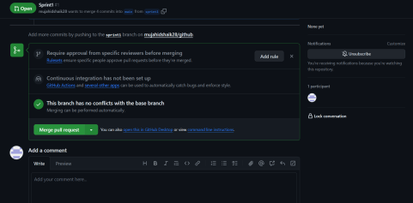




Slide 37
LAB – 9 [PULLING NEW CHANGES IN LOCAL REPO]
TASKS TO DO :
To pull the New changes from remote repository to local repository.

Slide 38
Get in to local directory and switch to Main Branch.
Pull the changes in the remote repository using command [git pull]
Check the changes in the main branch.

Slide 39





Slide 40
THANK YOU

